Slide 1
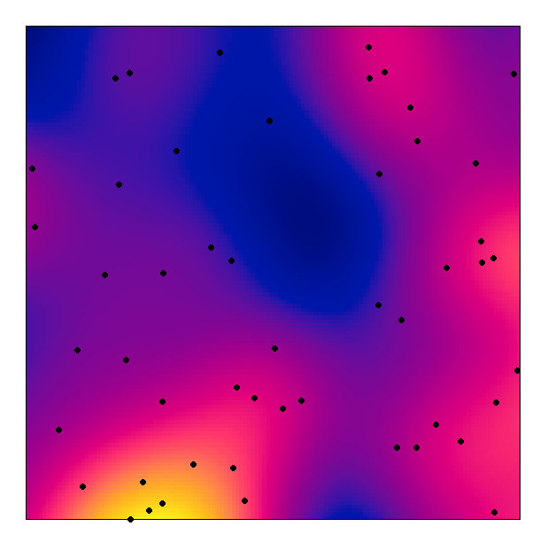
Spatial variation in risk
Hugh Sturrock 10/4/1017

Slide 2
Kernel Smoothing
Useful when you have a large number of data points
Generates continuous surface from point data showing density of cases
Method:
Window of a fixed size is placed over each point and a mathematical (kernel) function is applied which determines the degree of smoothing
Sum distributions at each location to give a kernel density distribution

Slide 3
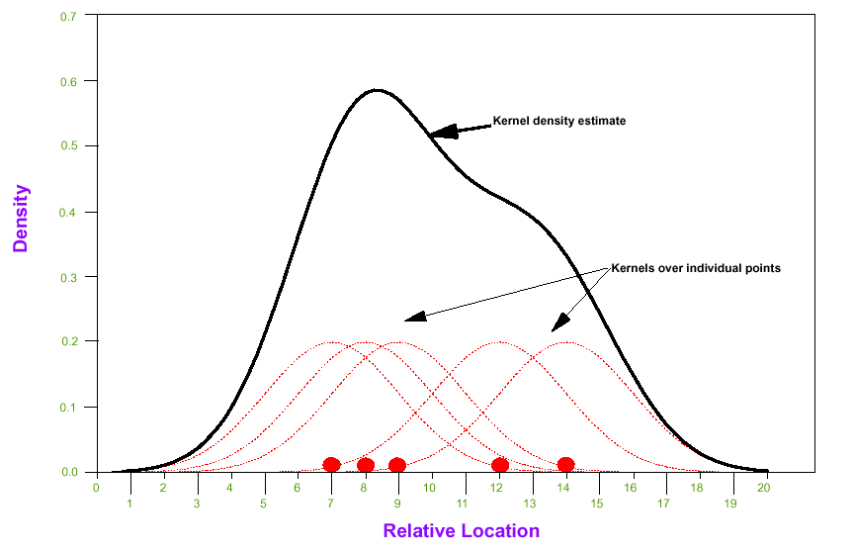
Images improve presentation of point data,
but the effect is strongly influenced by the parameters of the kernel estimator

Slide 4
Small bandwidth:
Large bandwidth:
Notes:
The degree of smoothing is influenced by the size and shape of the window – the larger the window the more information is “borrowed” from the neighbouring areas.
Larger windows: advantage – the resulting smoothed estimate is more statistically precise
Disadvantage – bias, especially in spatially heterogeneous areas as estimates will be influenced by points a long way away.

Slide 5
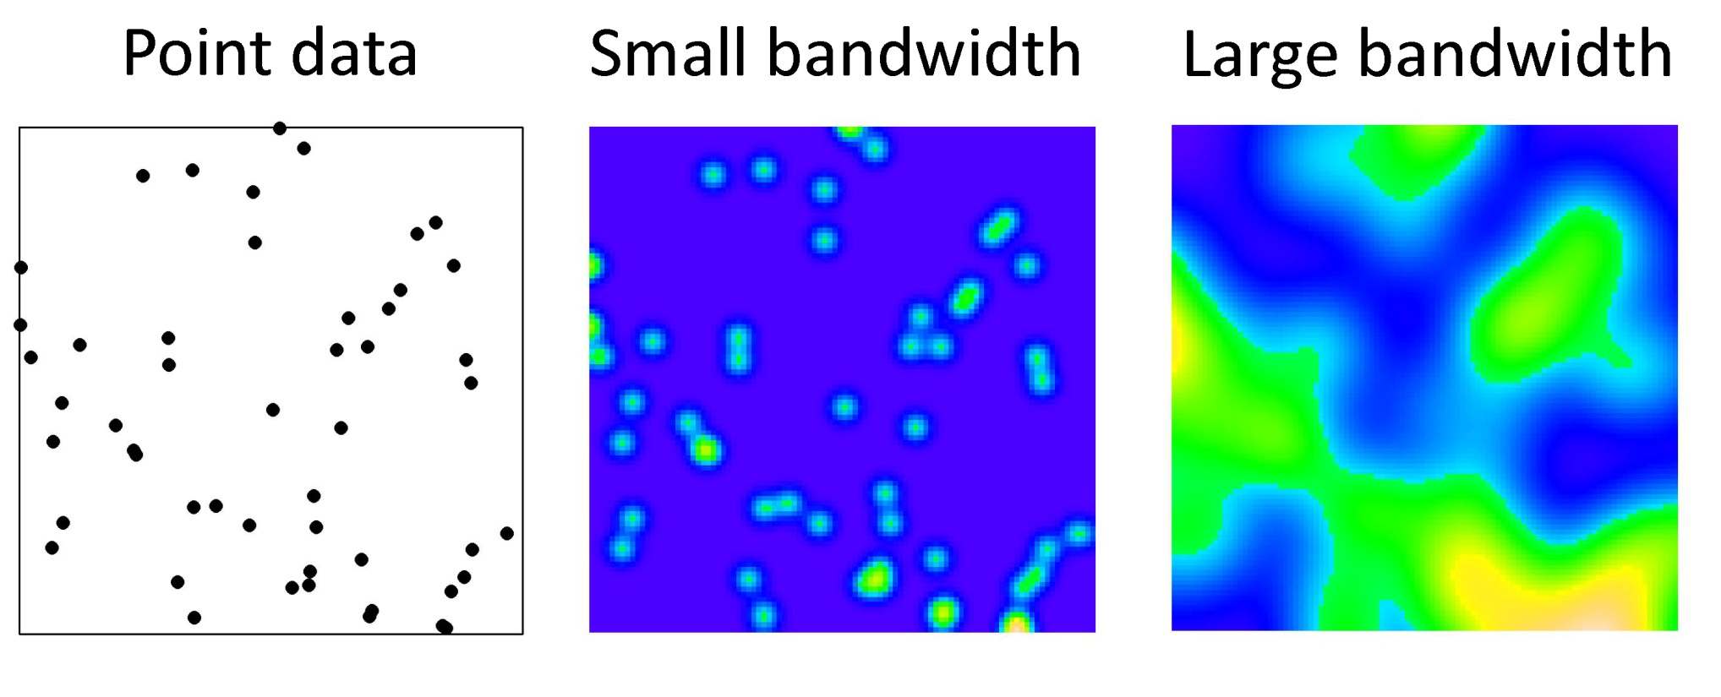

Slide 6
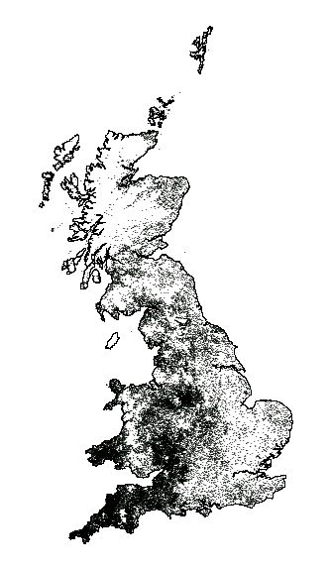
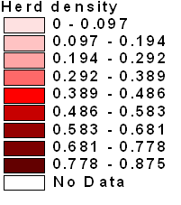
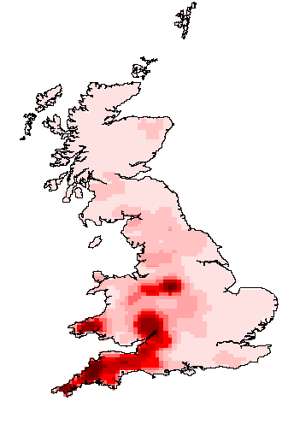
Point map - locations of all cattle herds tested for TB in 1999
Kernel density map of cattle herds tested for TB in 1999

Slide 7
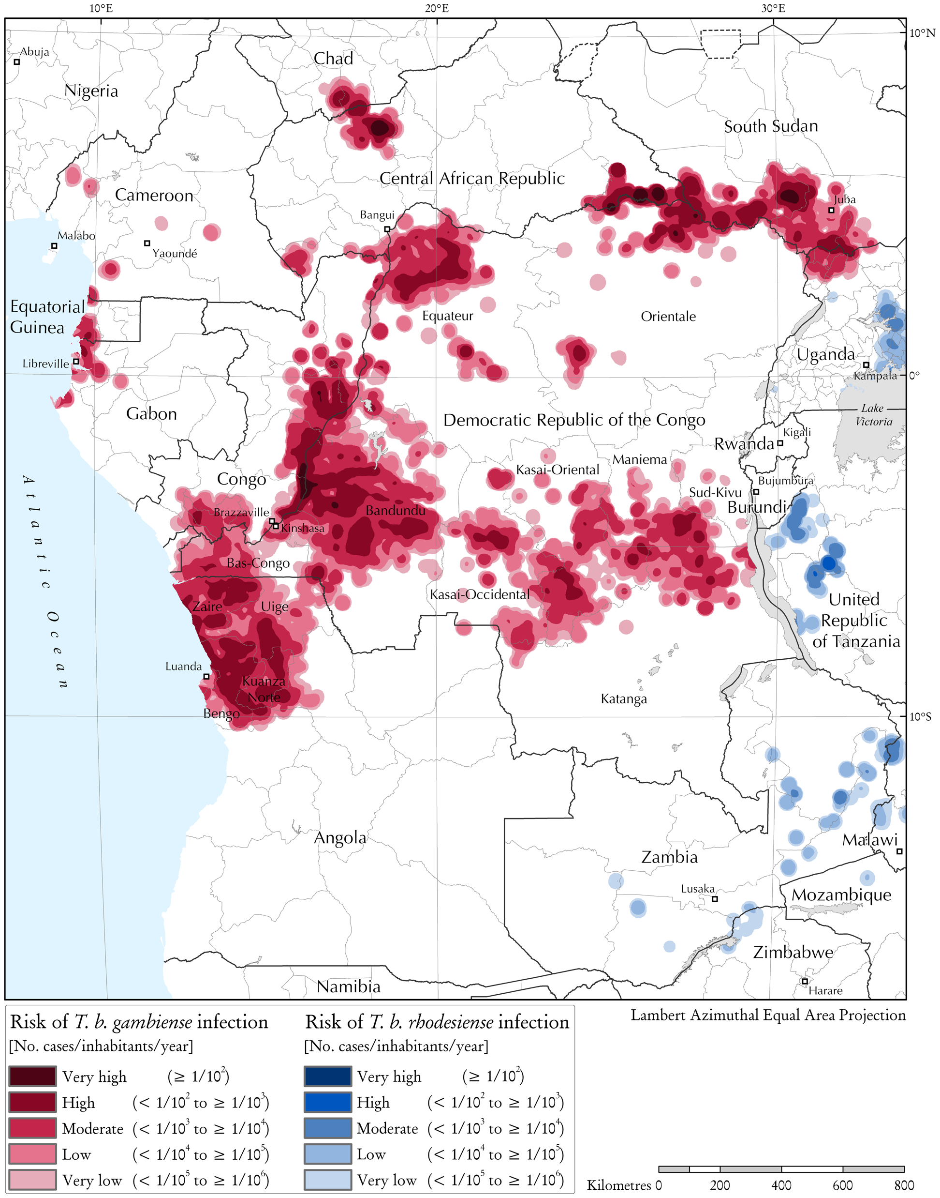
Kernel density estimates can also be used for estimating relative risk
r(u) = p(u)/(1- p(u))
Where p(u) is the probability that a point at spatial location u will be a case estimated by dividing kernel density estimate of cases by density estimate of controls
The risk of T. b. gambiense infection in central Africa (2000–2009).
Simarro, Pere P., et al. "Estimating and mapping the population at risk of sleeping sickness." PLoS neglected tropical diseases 6.10 (2012): e1859.

Slide 8
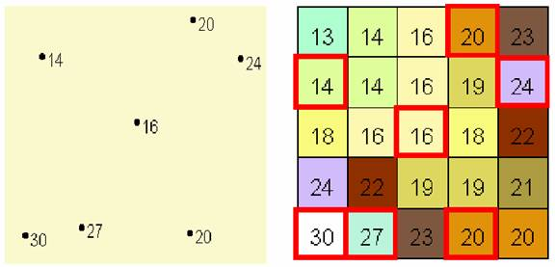
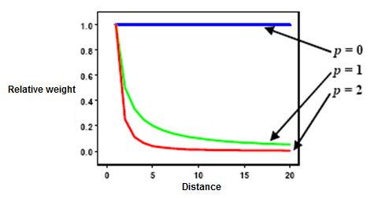
Interpolation - IDW
Various methods of interpolation available
Makes the assumption that things close to each other are more similar to each other than things far apart.
Inverse distance-weighted (IDW) uses a weighted average of neighbouring values, where weights are assigned relative to distance and a ‘power’ function. Larger the power, the greater weight put on nearer values

Slide 9
Kriging
Similar to IDW, but formally models the correlation between points as a function of distance to optimize weights
Semivariograms are used to describe and model spatial autocorrelation
Required for Kriging

Slide 10
Semivariograms
Distance matrix
A
 | A | B | C | D
A | 0 | 0.5 | 1.5 | 1.5
B | 0.5 | 0 | 1.5 | 1
C | 1.5 | 1.5 | 0 | 2
D | 1.5 | 1 | 2 | 0
0.5
1.5
B
1.5
C
1.5
Semivariance matrix
1
 | A | B | C | D
A | 0 | 0.2 | 2.4 | 2.1
B | 0.2 | 0 | 3 | 1.1
C | 2.4 | 3 | 0 | 5
D | 2.1 | 1.1 | 5 | 0
2
D

Slide 11
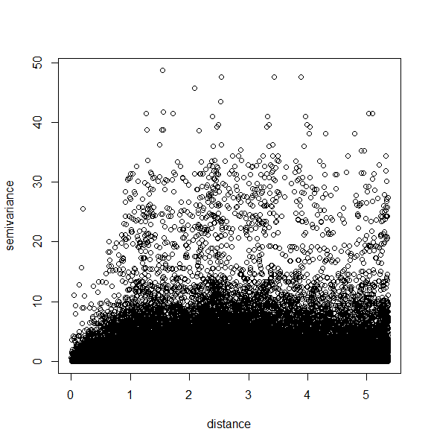
Semivariance

Slide 12
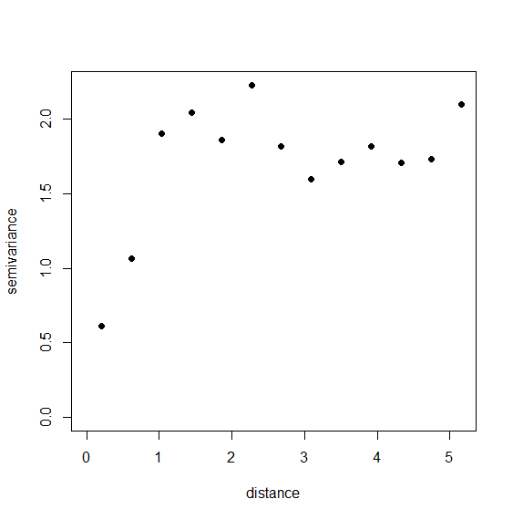
Semivariogram

Slide 13
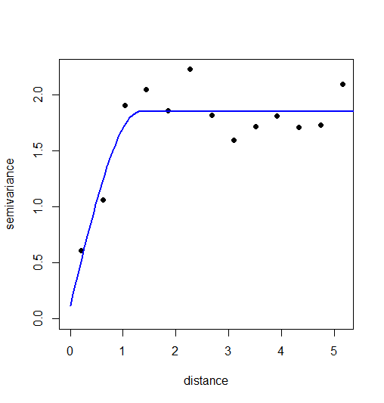
Semivariogram
Range
Sill
Nugget

Slide 14
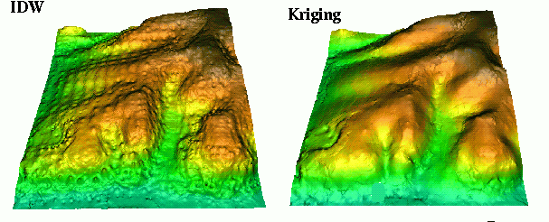

Slide 15
Model-based geostatistics
Kriging used in conjunction with regression modeling
Fixed effects used to describe large scale patterns (related to temperature, elevation etc) with spatially autocorrelated random effects estimated using kriging
Not only do spatially autocorrelated random effects help with prediction, if accounted for during modeling, assumption of independence isn’t violated
Popular method for risk mapping using point-level data
Normally Bayesian inference as complex models require MCMC sampling for parameter estimation

Slide 16
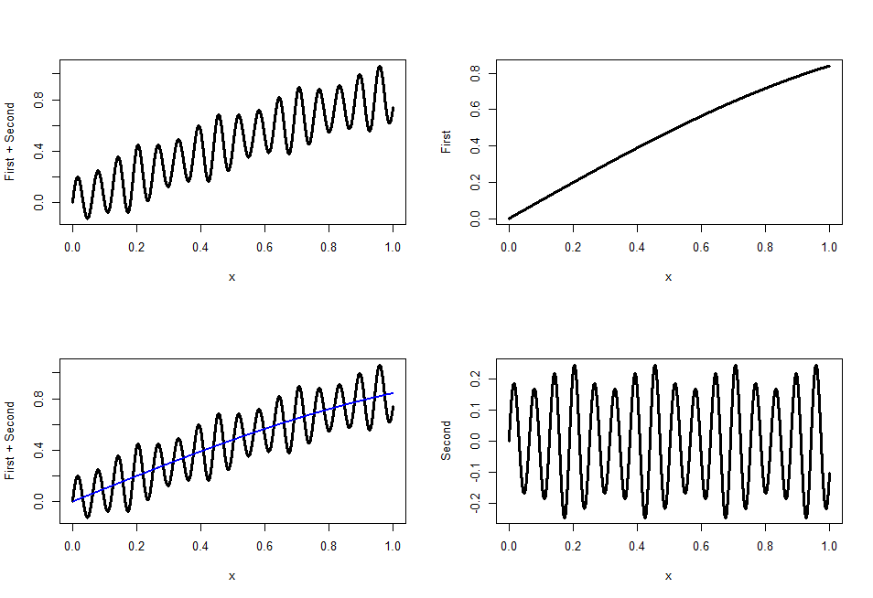
Model-based geostatistics

Slide 17
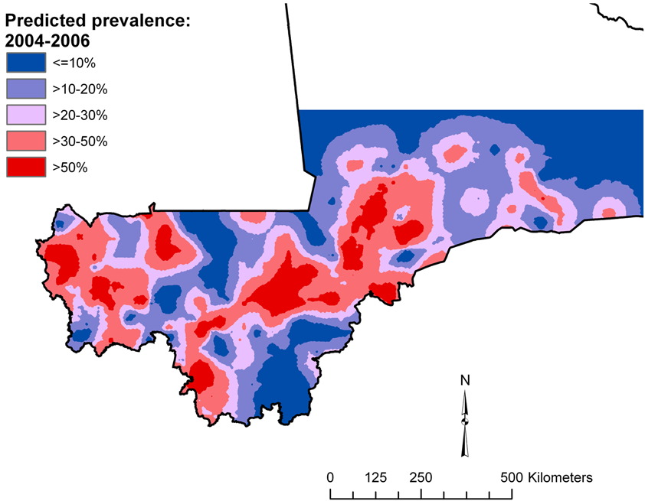
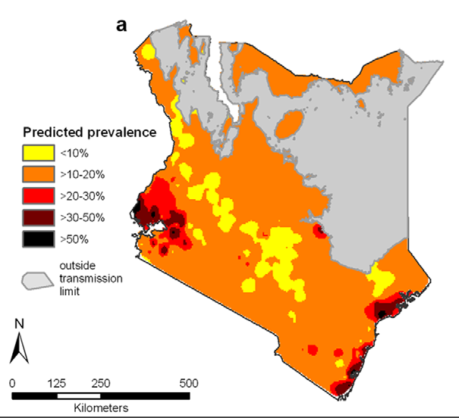
Model-based geostatistics
Schistosomiasis in Mali
Clements et al (2009) PLoS Negl Trop Dis 3(5): e431
Intestinal worms in Kenya
Pullan et al (2011) PLoS Negl Trop Dis 5(2): e958

Slide 18
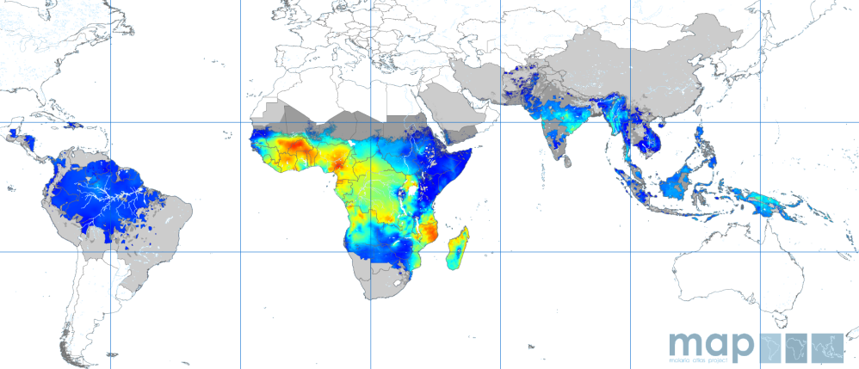
Model-based geostatistics
Malaria in 2010
Gething et al. (2011) Malaria Journal, 10:378

